Slide 1
DXS Optics Simulation
Nan Wang, Apr 30th 2021

Slide 2
Outline
Crystal heat-load deformation
Deformation profile
Beam profile (xz, yz central slices)
Beam profile around focal plane (xy)
Strehl ratio
HRM tolerance scan

Slide 3
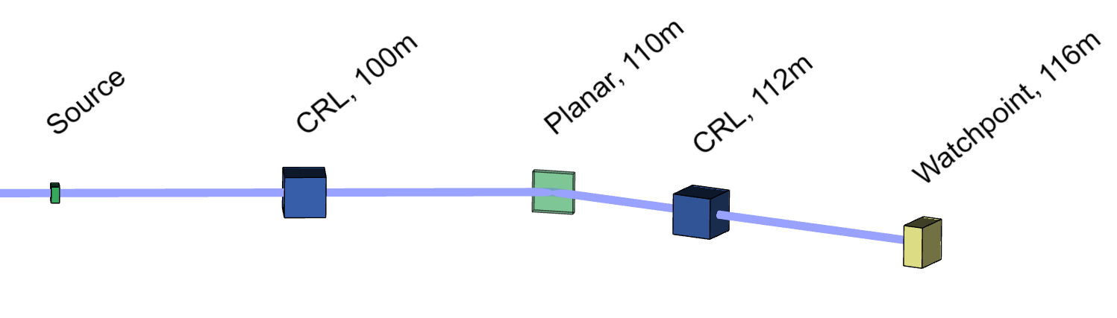
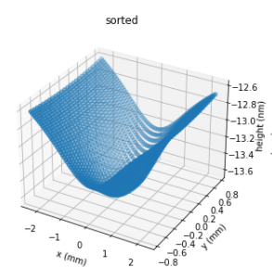
Deformation
Crystal deformation is simulated as the height error for a flat mirror. For a 250um (FWHM) beam profile, the RMS height error is ~88.7 pm at 70W.

Slide 4
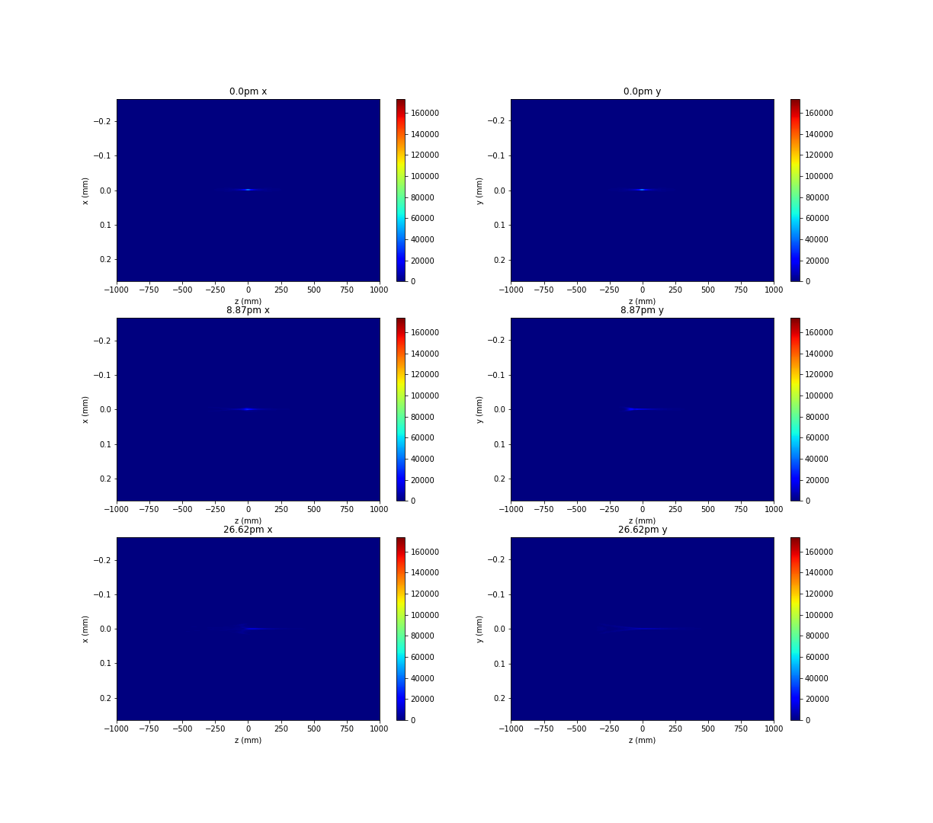
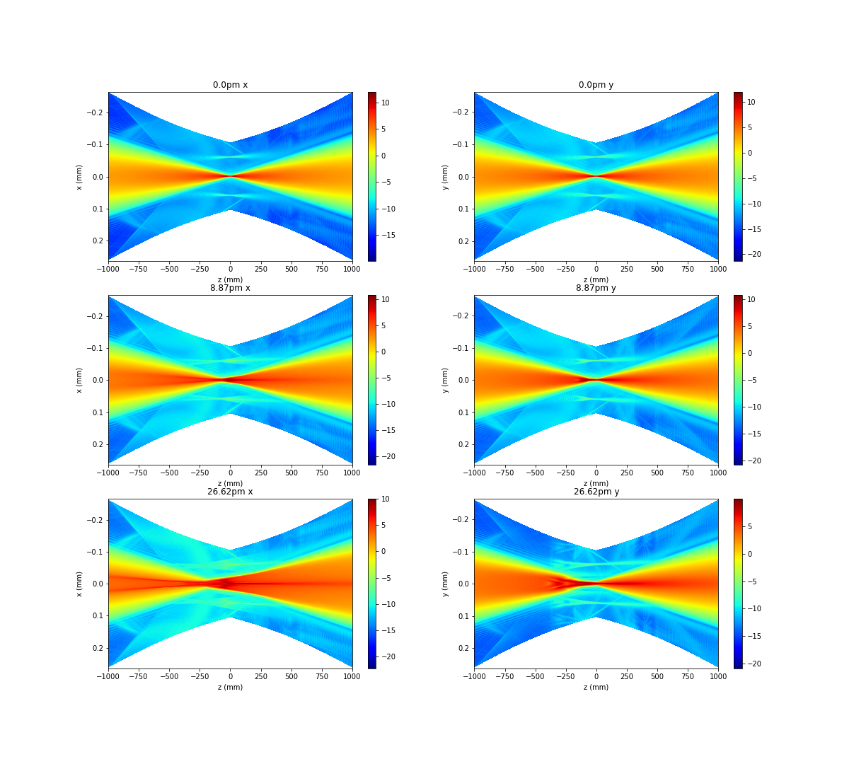
Beam profile vs height error

Slide 5
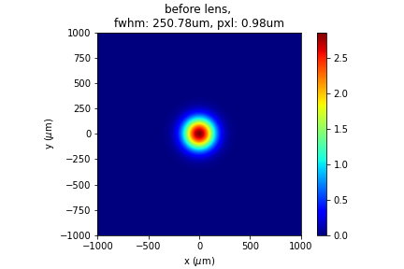
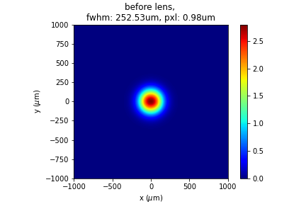
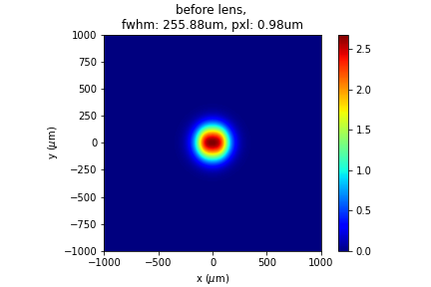
Around focal plane, ±25cm
flat mirror
8.87pm
26.62pm

Slide 6
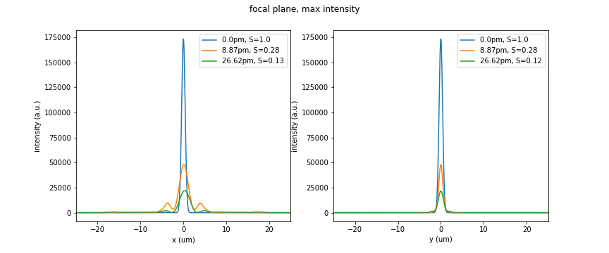
Strehl ratio
0.952
The theoretical Strehl ratio for the three cases are: 1.0, 0.952, 0.643 respectively. The simulated value is smaller due to astigmatism. Working on correction with 1D CRL.

Slide 7
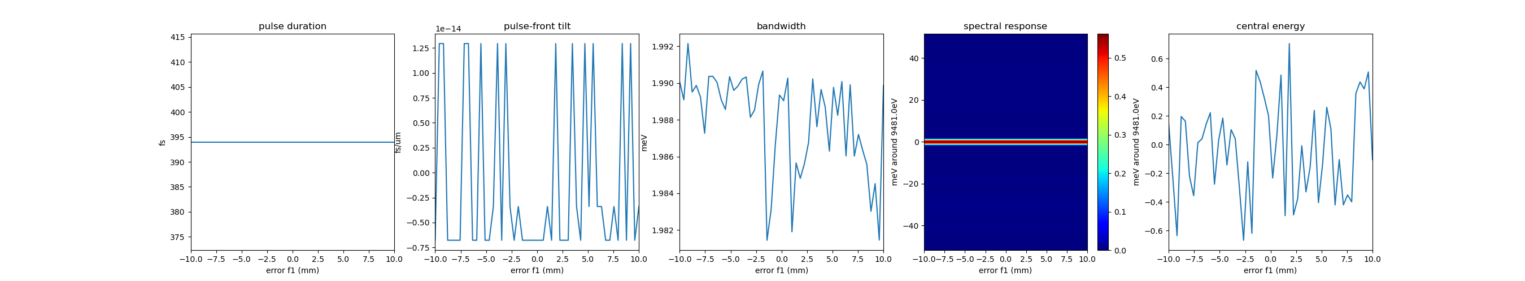
Crystal-lens distance

Slide 8
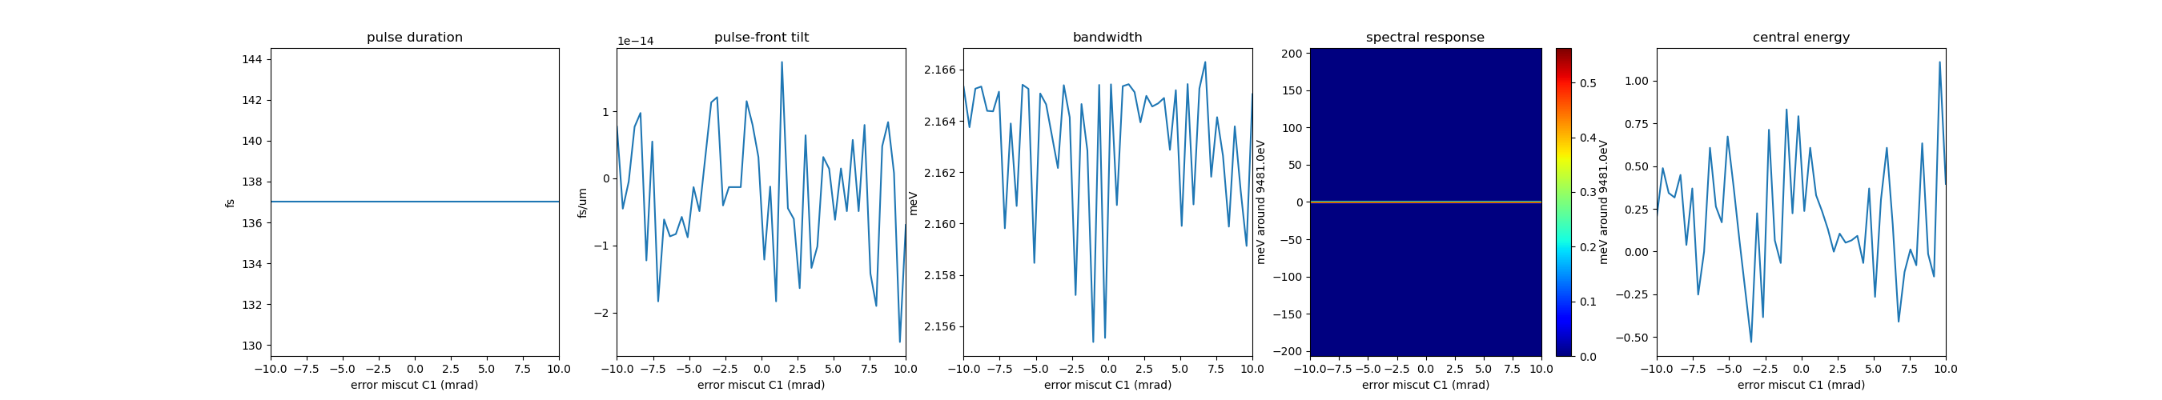
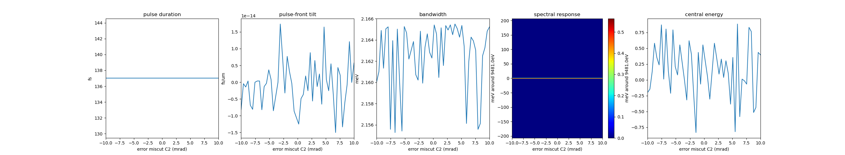
Crystal miscut error, C1, C2

Slide 9
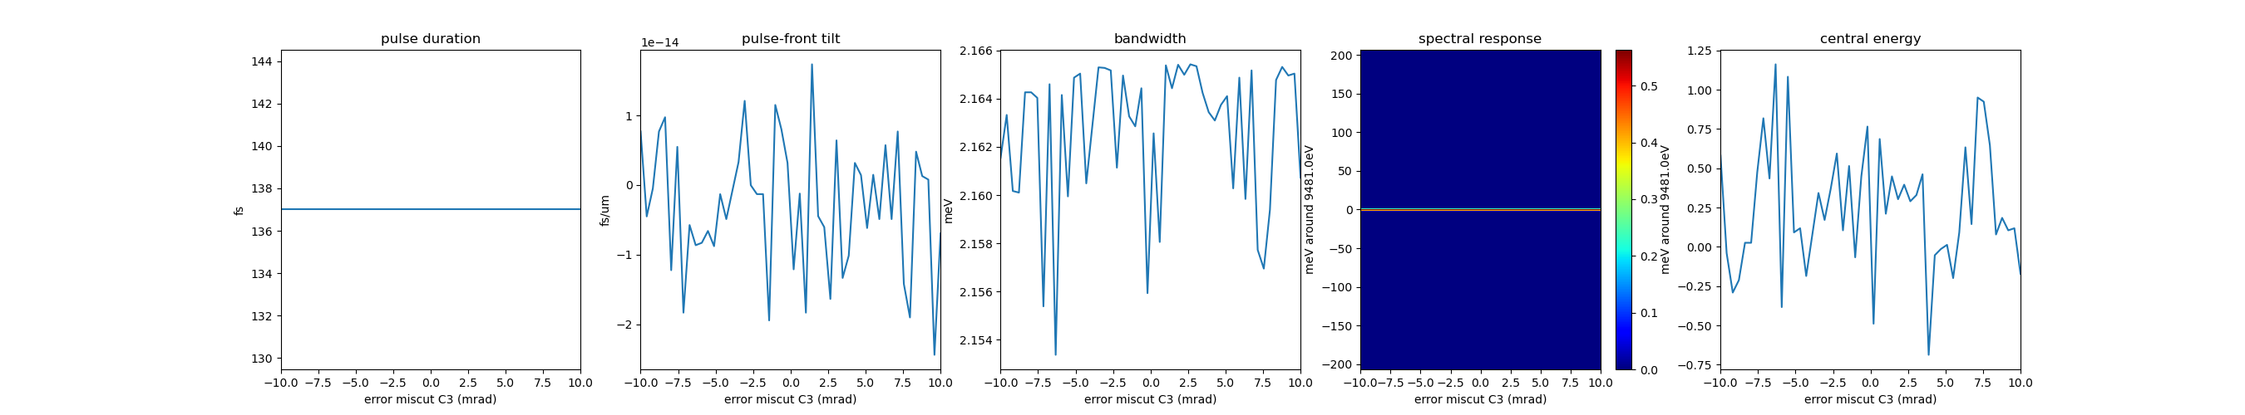
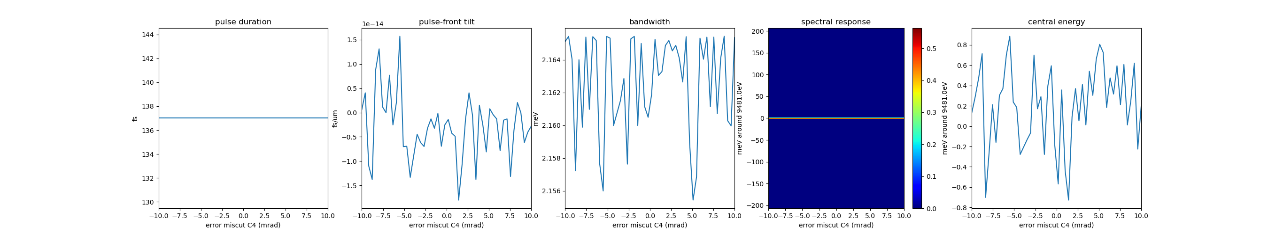
Crystal miscut error, C3, C4

Slide 10
To do
Finish the angular tolerance scan
Then switch to parabolic mirrors and for future simulations also do mirrors
SRW takes out quadratic terms for the parabolic mirrors
Divergent lens

